Slide 1
Strategy | April 20, 2022

Slide 2
Welcome Back!
SESSION 1
Program Introduction
SESSION 2
Budgeting, Forecasting & Financial Reporting
SESSION 3
What do we want from a CFO?
SESSION 4
Capital Sources, Debt & Equity
SESSION 5
Audit & Tax
SESSION 6
Executive Leadership
SESSION 7
Indirect Rates & Pricing Strategy
SESSION 8
Buy & Sell Side M&A
SESSION 9
Communication, Team Building & Accountability
SESSION 10
CFO Oversight Areas & Continuing Education
SESSION 11
Strategy
SESSION 12
Program Recap-Capstone
Notes:
Brian Presents

Slide 3
May 18th Capstone event-
Taking place where? We ask that you please RSVP to us so we have proper headcounts. We will be making important announcements for 2022-2023 at the Capstone event so we encourage you to please attend
Alliance/CBRE Charity Golf Tournament- May 9th
Latest books from Stewart Leadership-
Please let us know if you did not receive copies
Announcements
Notes:
-expand or shorten width of orange box for even spacing on all sides of Section Title text

Slide 4
Webinars hosted by BDO-
Selecting a Govcon ERP
In case you missed it, BDO hosted this webinar today. Feel free to access the recording by following this link. https://www.bdo.com/insights/industries/government-contracting/bdo-s-government-contracting-webinar-series
Mergers & Acquisitions: Considerations for Government Contractors
May 17, 2022
12:00 - 1:00 PM EST
Speakers: Chandra Chudamani and Kasra Mojtahedi ( we will share the link)
Announcments
Notes:
-expand or shorten width of orange box for even spacing on all sides of Section Title text

Slide 5


New Job Alert!
Jason Kain
Vice President of Finance
MAG Aerospace
Congratulations Jason!

Slide 6

Tonight’s Agenda
Defining Strategy
Deconstructing Strategic Planning
The CFO’s Role in Strategy
Break-out Session
Q&A
  CLIMB: Coach, Learn, Inform, Mentor, Benefit
Notes:
Mandatory slide to suggest the Goals for the Session. White space at right is flexible as needed.

Slide 7
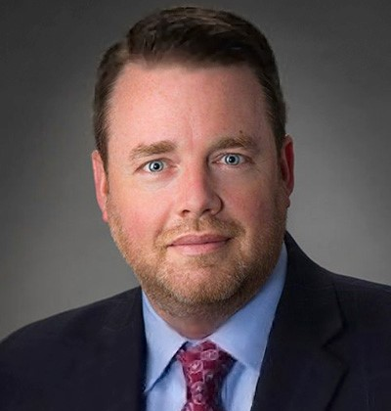
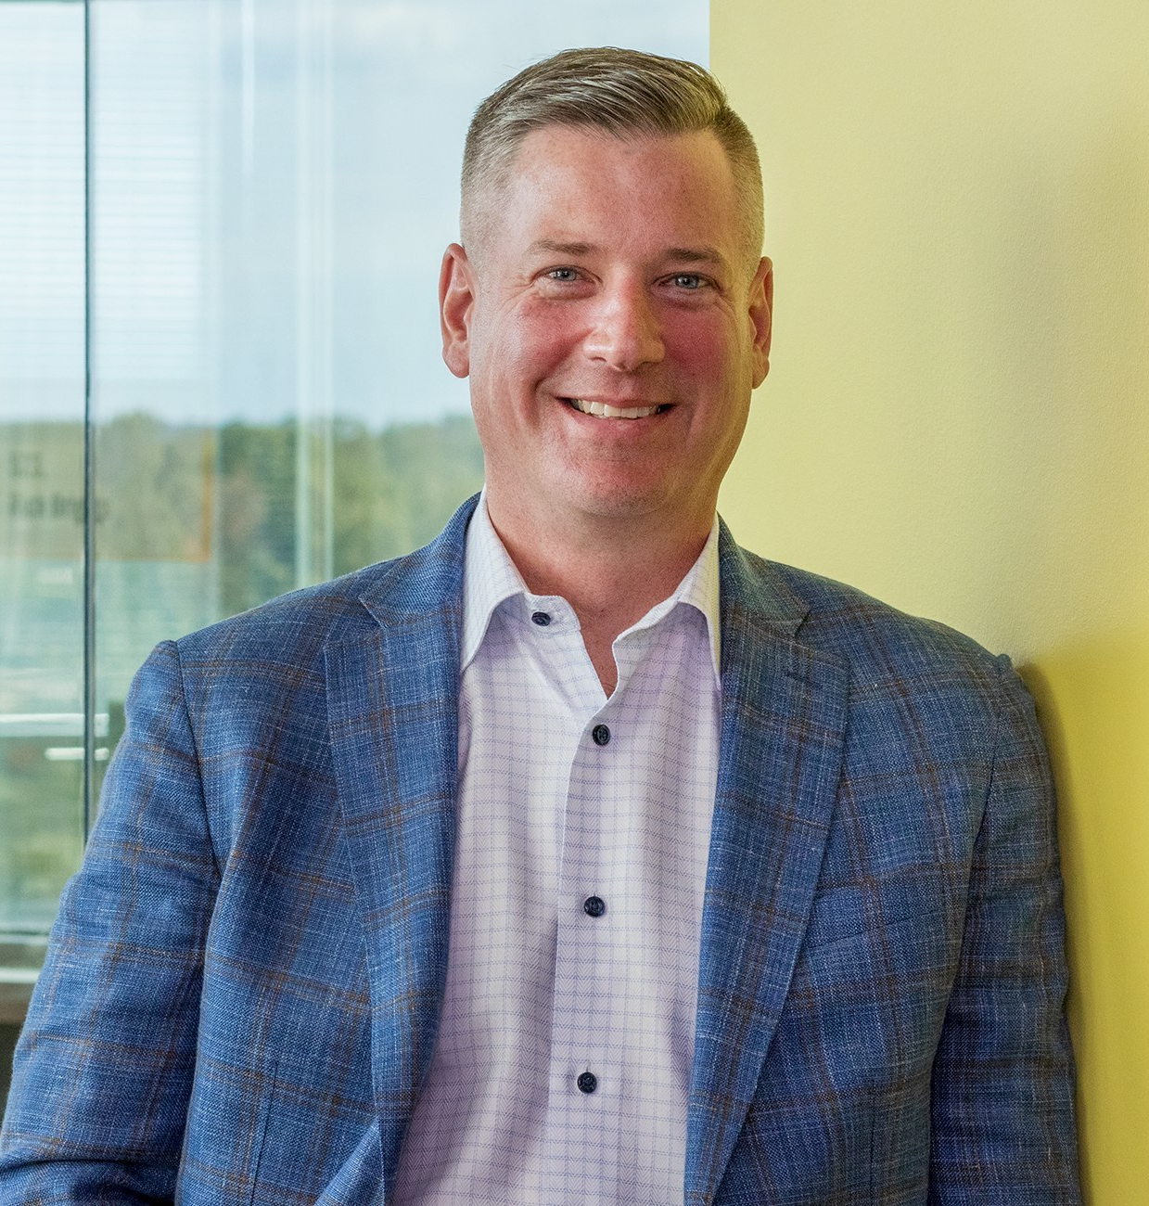
Strategy
      Gordon Foster & Brian Drzewiecki
        CFO, SERCO CFO/COO, RII
Notes:
Mandatory Slide to introduce the next topic/session. To be briefed by the MC.

Slide 8
CFO are Responsible for Three Primary Areas
(from CFO Rising session 10)
Installing controls and protecting the assets of the company (physical, intellectual and human)
Providing analysis of and insight into financial performance and operational objectives of the company
Share operational control with the executive team to ensure the achievement of the strategic plan of the company
STRATEGY
Compliance & Recommendations → Co-Operating the Business

Slide 9
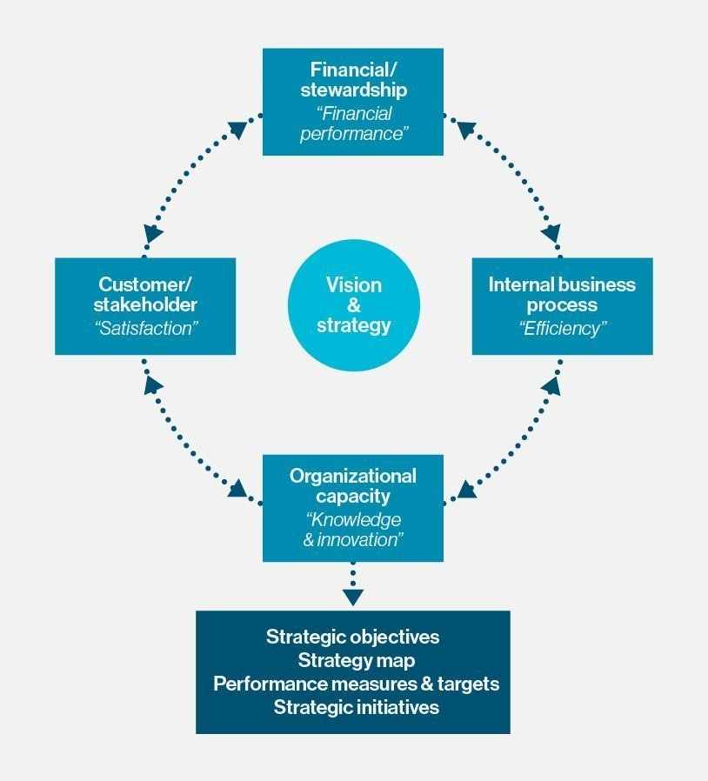
Strategy
_
A business strategy is the combination of all the decisions taken and actions performed by the business to accomplish business goals and to secure a competitive position in the market.
A business strategy outlines the plan of action to achieve the vision and set objectives of an organization and guides the decision-making processes to improve the company’s financial stability in a competing market.
Defines what we do and DON’T do
A high-level plan that helps a business achieve its goals.
A business objective without a strategy is just a dream. It is no less than a gamble if you enter into the market without a well-planned strategy.
Static vs Dynamic Strategy (annual/on-going)

Slide 10

What does being Strategic really mean?
The organization takes an outside perspective: in view of how things are, and should be done (in other words, they base their methods and operations on what customers want, not what they do)
Organization are proactive: strategic companies make things happen at a time that suits them, rather than waiting for events to force them to change
Everything is aligned: the entire organization is committed to the journey, not just a function or two
Everyone involved is committed to an inspiring vision and purpose
A good definition is simply: “Being strategic means ensuring the organization's core competence is consistently focusing on those directional choices that will best move the organization toward its new future, with the least risk and in the most orderly fashion”
How does finance fit into the above approach? How can you position yourself to be “strategic”?

Slide 11


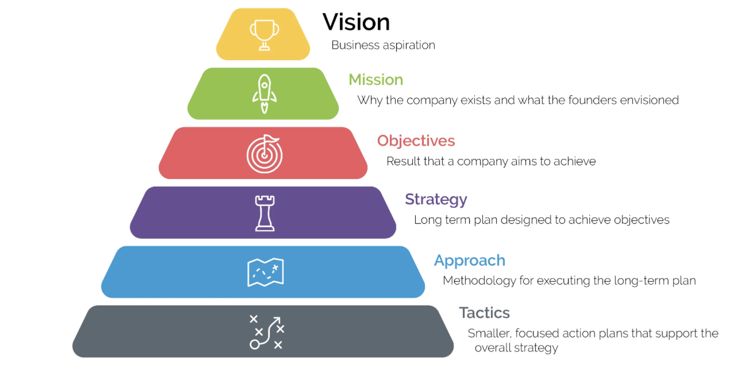

Elements of Strategic Planning
“To be the world’s most customer-centric company.”
“For every person to use their unique experiences and backgrounds, together – to spark solutions that create a better, healthier world.”
During the Strategic Planning process, organizations perform three steps:
Builds or modifies the foundational strategic vision and mission
Commits to goals that drive overall health
Develops a long-term plan to achieve the goals
“To make people happy.”
Should this be your “BHAG”?
Notes:
Define your vision: An organization’s vision statement is an aspirational description of what it wants to achieve in the future.
Create your mission: While your vision is an organization-wide goal, your mission how you plan to achieve the vision
Set your objectives: Objectives are specific results that a person or system aims to achieve within a time frame.
Develop your strategy: Your strategy is a long-term plan that enables you to achieve your organization’s objectives.
Outline your approach: An approach provides a methodology for executing your strategy.
Get down to tactics: Tactics are focused initiatives, projects, or programs that allow organizations to execute a strategic plan.

Slide 12
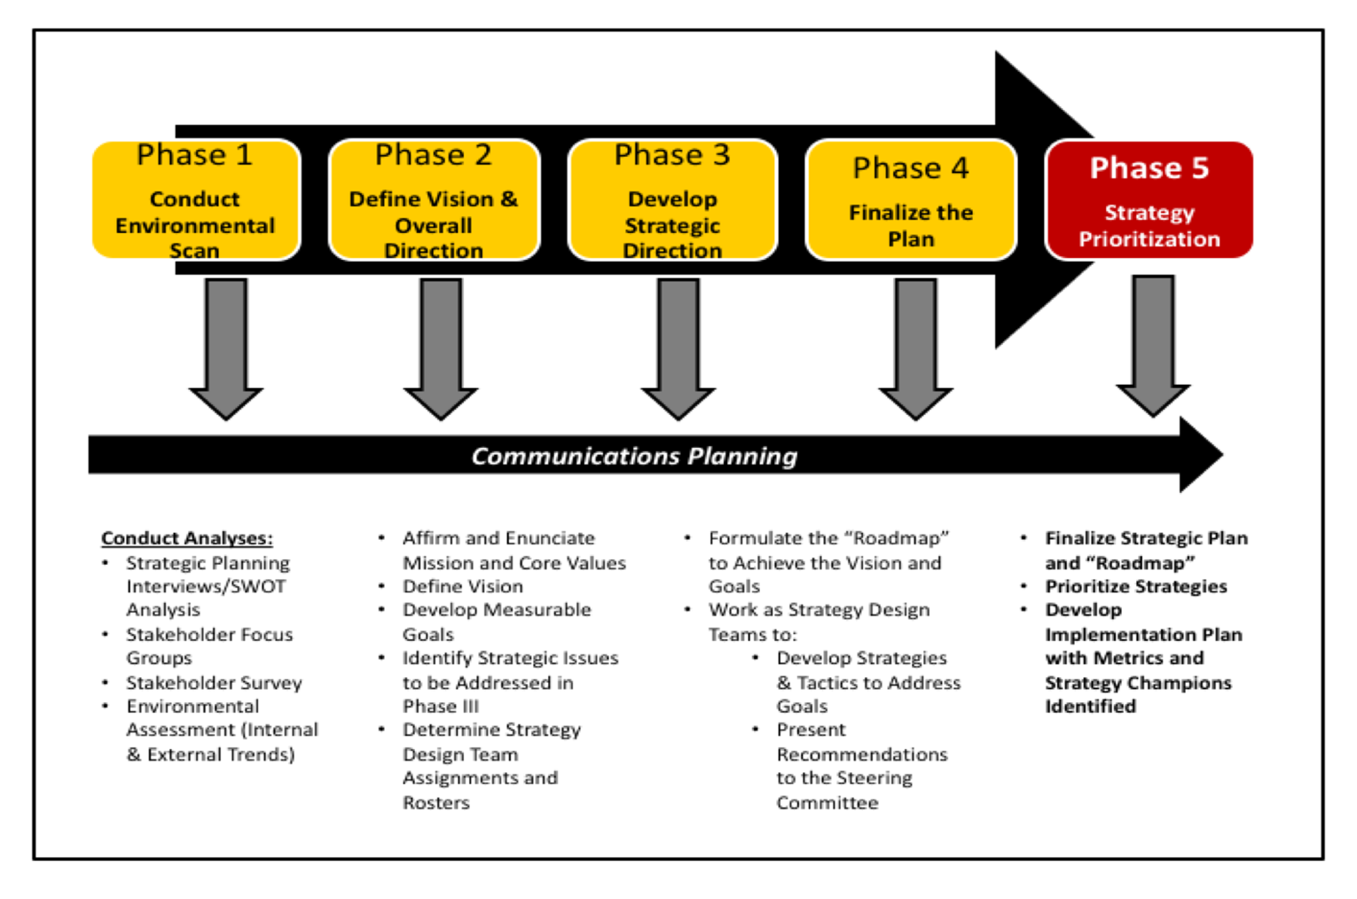
Strategic Planning Cycle
April - July
Communication Regular stakeholder meetings
May 2021 Onward: Integration & Growth Strategy Discussions
Notes:
Brian Presents

Slide 13
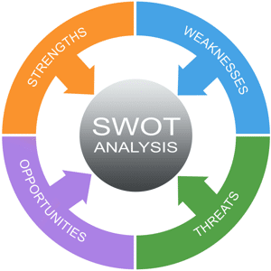
SWOT Analysis
Business strengths – attributes that help achieve company objectives (reputation, key technology)
Business weaknesses – characteristics that hinder achieving company objectives (high turnover, lack of technical depth)
Threats to the business – external factors (competition, changing customer behavior)
Opportunities for the business – external factors that help achieve company objectives (new emerging markets, vendor partnerships,I ncrease in market demand)

Slide 14
Business Areas - Investment
Avoid | Fix Or Exit | Maintain | Invest To Grow | Enter New Segments | Enter New Geography | Explore*
[Segment A] | [Segment B] | [Segment C] | [Segment D] | [Segment F] | [Segment G] | [Segment H]
 |  |  | [Segment E]
RATIONALE FOR THE ABOVE
E.g. Declining client budget / appetite for X E.g. emerging gvnt policy which impacts attractiveness of this market | E.g. negligible market size and limited growth potential due to X | E.g. Strong pipeline and high ability to win (new business win rate of X%) E.g. Of strategic importance to the BU due to X | E.g. Sizeable market (Xm) with x% growth expected between X and Y and medium to high ability to win E.g Huge number of emerging and attractive opportunities (£m TCV) E.g two sizeable and strategically important contracts (X and Y) coming up for rebid in early 2022 | E.g. Attractive margins of X%, expected CAGR between X and Y of Z% and synergies with existing business | E.g. first generation outsourcing, offering attractive margins of X% and huge growth potential | E.g. Opportunity to build on existing partnerships

Slide 15
What role should strategy play in your organization
There is not one answer as to what role strategy should play in each organization
Varies by ownership
Varies by size
Varies by leadership
Varies by outside influence
Might be a 200-page ppt
Publicly Traded
Complexity of strategy increases with both axes
Ownership Structure
Might be in 25-page PPT
Funded (VC or PE)
Founder / Family Led
Might be in their head(s)
Small
Medium
Large
Business Size

Slide 16
Strategy – Questions to consider
  Why is the company in business?
  What product(s) or service(s) do you provide? What is the job to be done?
  Who are your customers?
  What is our core strength? What are our weaknesses?
  Which customers should we continue to serve or start serving?
  Which products/services should we stop offering, continue to offer or start offering?
  How should resources be allocated: infrastructure, LOB operations, sales/business development, Marketing, IR&D, other investment
  Why have we decided on these strategic directions?

Slide 17
Strategy – Defined
The Difference Between Strategic Planning and Strategic Thinking
https://youtu.be/V2Hndmk18z0
Martin Reeves: Your strategy needs a strategy
https://youtu.be/YE_ETgaFVo8
4 Key Elements of an Effective Strategic Plan
https://youtu.be/74maeLEbdwk

Slide 18
Break-out Session
4 Teams – Answer the following questions based on the below criteria
Let’s discuss….
Team 1: Tech start up that has developed a microwave-emitting pod that can sit on the bottom of heavy lift drones and quickly down sudden drone swarms from an enemy. They are looking for venture funding with no revenue yet.
Team 2: $400M PE backed Government Services provider that has recently acquired 2 small companies and is looking to exit in 4 years
Team 3: $10B Publicly traded company in the Government Services space (ie Leidos)
Team 4: $30M privately owned (wife & husband) WOSB that has organically grown over the last 15 years
What would be the core components of your strategy?
Who would lead the strategy planning?
How would you present your strategy document?
What time of year would you start your strategy development and when would you finish?
How would you implement your strategy across the organization?
What role would the CFO/Finance leader play in the strategy planning?
4 Teams
20 minutes
Answer the questions below
Choose a speaker or present as a group

Slide 19
Strategic Thinking vs. Strategic Planning
There are many schools of thought around strategic planning, insofar as organizations developing strategic planning cycles that effectively suppress the “strategic thinking” aspect that is vital to strategy formulation. Several authors put it best….
  “Strategic planning isn’t strategic thinking. One is analysis, and the other is synthesis” Henry Mitzberg, The Rise and Fall of Strategic Planning
  “As we’ve mentioned several times, the strategic planning process comprises two distinct activities: strategic thinking and execution planning. Strategic thinking is coming up with a few big-picture ideas. Execution planning is figuring out how to make them happen” Verne Harnish, Scaling Up
Group question: Share an experience with Strategic Planning – was the process more planning & analysis? Or “out of the box thinking”? Dynamic or Static? Where was finance’s role in the process? Beginning, end or throughout?

Slide 20
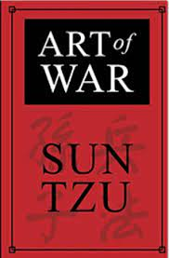
Are You a Tactical or Strategic CFO?
As financial leaders, we have access to reams of data and information that underlies the performance of the business. During strategy formulation, we can be seen as “sounding boards” or “the realists in the room” or even, “the CF-NO”…several common hurdles on CFO’s path to become more strategic and transformational:
  Pushing yourself to think outside your comfort zone; ask questions as to how the strategy will serve the “jobs to be done” for the market, product and/or service. Overcome the tendency to be “the number cruncher”!
  Develop dynamic planning processes, which deliver data with connection to how it underpins the strategic vision for the company; actionable and relevant
  Abandon the mindset that the strategy must always “add up” to a number or target; separate “thinking” from “planning”. Focus on the strategy and tactics – both are necessary for the organization to achieve their goals
“All men can see the tactics whereby I conquer, but what none can see is the strategy out of which victory is evolved” Sun Tzu, The Art of War

Slide 21
Evaluating Strategy when you join the company
Who owns the strategy document (CEO, Strategy, BD, PE)
What role do the owners play
  If P/E is part of your strategy already defined?
How frequently is it updated – static or dynamic?
Does it drive daily decision making (operationalize it)
Does the infrastructure strategy support the business growth strategy?
Scaling for growth is a key driver to achieving the growth aspirations
  Moving from $5M to $15M, $50M to $100M, or $500M to $1B

Slide 22
Role of the CFO in Strategy
Long range budget planning
Financial SWOT
Identification of business risks
Framework for budgets and investments
Rationale for spread of investment across the Functional organizations/infrastructure and Business Units
Indirect rate structure & forward pricing rates framework
Briefing to the Board or ownership

Slide 23
Life Lessons by Gordon and Brian
Learn the details, know the details, differentiate yourself by application of the details
Get out and ask questions of the customers, internal and external, about what is the “job to be done” for your products & services
Don’t revert to your comfort zone; push yourself to provide meaningful insights by being knowledgeable about more than the numbers
Challenge the status quo expectations of finance & accounting…make a seat at the table.
Demonstrate learning agility…be pragmatic when it comes to areas outside of your sphere of knowledge, by providing salient insights that drive discussion / debate
Surround yourself with good people who can deliver you timely, relevant and dynamic data to underpin your role as CFO; if you are ”chasing data” all day, your effectiveness as a “Strategic CFO” diminishes
”See the Field”…look to find the connections in products, markets, acquisitions, competition

Slide 24
Open Discussion
What’s worked well and what hasn’t?
How do you help the organization stay focused on what matters during and after strategy development?
How can the CFO influence and persuade strategy?
What key relationships should you be building across the ELT and leadership teams to improve the success?
Thinking about your network- what executives do you know who do this well that can help you develop this area?

Slide 25
Thank you!
Any Questions??
25

