Slide 1
The Ever-Expanding Role of the CFO | MARCH 16, 2022

Slide 2
Welcome Back!
SESSION 1
Program Introduction
SESSION 2
Budgeting, Forecasting & Financial Reporting
SESSION 3
What do we want from a CFO?
SESSION 4
Capital Sources, Debt & Equity
SESSION 5
Audit & Tax
SESSION 6
Executive Leadership
SESSION 7
Indirect Rates & Pricing Strategy
SESSION 8
Buy & Sell Side M&A
SESSION 9
Communication, Team Building & Accountability
SESSION 10
CFO Oversight Areas & Continuing Education
SESSION 11
Strategy
SESSION 12
Program Recap-Capstone
Notes:
Brian Presents

Slide 3
BDO- Amy Thorn
Stewart Leadership- Dave Thurston
Capstone- May 18th (mark your calendars)
Announcements
Notes:
-expand or shorten width of orange box for even spacing on all sides of Section Title text

Slide 4

Tonight’s Agenda
  CLIMB: Coach, Learn, Inform, Mentor, Benefit
Meet Alan and Rich
Considerations of Becoming a CFO
Expanding the CFO’s Role
Break-out Session
Q&A
Notes:
Mandatory slide to suggest the Goals for the Session. White space at right is flexible as needed.

Slide 5
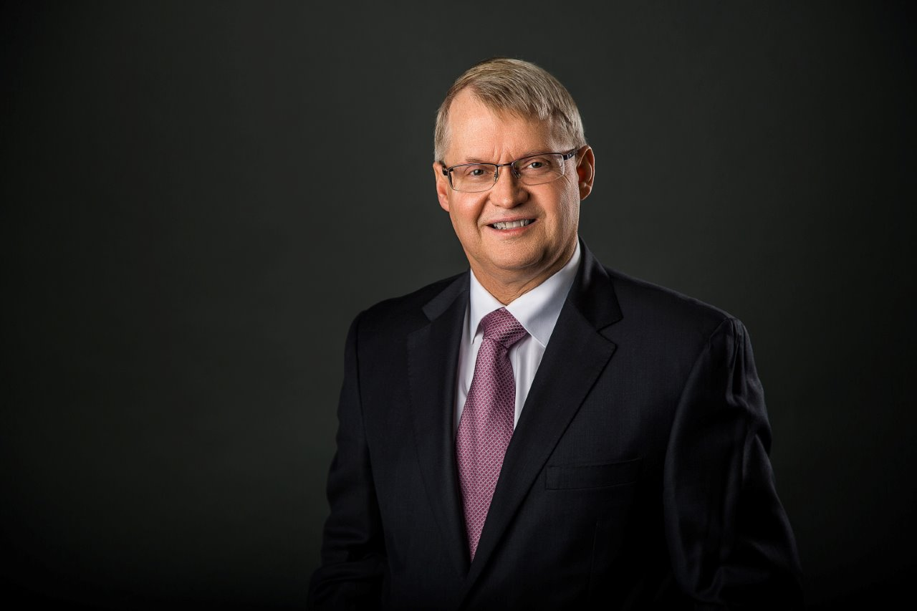
Alan Stewart
Successful IPOs for three different companies. Prepared two others for potential IPO achieved by successors.
Over 40 quarters of public reporting at three separate corporations, while meeting or exceeding analyst expectations, in addition to no restatements and no significant auditor adjustments, or material weaknesses.
Closed eight credit agreements at ICF in nine years with a total capacity of over $900 million. Established new bank relationships, credit agreements, revolvers & compliance at several companies. Narrowly avoided default on a major loan.
At ICF, successfully acquired 10 companies and completed their subsequent integrations, in addition to three dispositions of non-core business units.
Successfully completed over 42 audits on the three-year $900 million Louisiana Road Home post-Katrina contract, which distributed over $8 billion in federal grants with essentially no waste, fraud or abuse.
Cumulatively, worked in some capacity on several dozen acquisitions, due diligences, closings, integrations and cleanups (i.e. indemnity claims).
Established or completed the hiring and organization of various corporate departments at multiple companies.
Live in Vienna VA with wife of 36+ years, 2 daughters in college (adopted as infants in China). 20+ years involved in martial arts.

Slide 6
45-Years of Alan Stewart

Slide 7
Executive management
Company |  | Executives
Martin Marrietta |  | Norman Augustine
C3, Inc. |  | Richard Litsinger, Norm Welsh
Tempest Technologies |  | Delaney Blaine, David Lucien
Policy Management Systems
BTG |  | Dr. Edward Bersoff
Deltek Systems |  | Don & Ken deLaski
Blackboard |  | Michael Chasen & Mathew Pittinsky
DataZen |  | Michael Keeler
ICF International |  | Sudhakar Kesavan, John Wasson
Oceus Networks |  | Douglas Smith, Randy Fuerst
Vistronix |  | John Hassoun
Systems Planning & Analysis |  | William Vantine
Peraton |  | Stu Shea

Slide 8
Summary of Major events
Spinoff from public companies:
  Tempest Technologies
  Ericsson Federal/Oceus Networks
  ICF International
  Peraton & purchase of Northrup Grumman mission support and IT groups
Public companies, public offerings and reporting:
  Tempest Technologies. (IPO October 1987 Wednesday before Black Monday)
  BTG. (successor IPO’ed several years after I left)
  Deltek (February 1997)
  Blackboard (successor IPO’ed several years after the Dotcom crash)
  ICF International
  Forty-four quarters of successful public reporting and multiple opportunities to build corporate offices in occasionally over-leveraged environments.

Slide 9
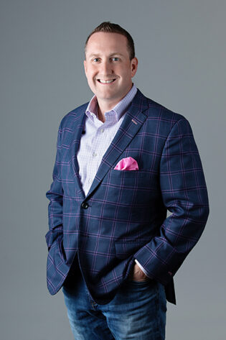
Rich Sawchak
Hypori’s CFO & Corporate Secretary
Joined Hypori in October 2021 after 9+ years with Novetta
Executive at Novetta during ACP & Carlyle ownership; drove successful sale to Accenture
20+ years of leadership roles with extensive experience in the execution and integration of acquisitions as well as fund-raising
  Involved in or led over 40 transactions
  Debt & equity fund-raising incl. IPOs and rated/traded debt
Responsible for all areas of finance, accounting, sales operations, compliance, legal & HR/recruiting
Prior to Novetta, EVP & CFO at Shafer Corporation and SVP & CFO at Paradigm Solutions (orchestrated sale to CACI)
Member of the board for SPA, Inc. and GCA/networked, and trustee of University of Valley Forge
Holds a B.S. from Boston College and a Master’s in Entrepreneurial Finance and Strategic Cost Management from Babson College
Resides in Leesburg, VA with wife Jenn and daughter Ally; 2nd dan blackbelt in taekwondo

Slide 10
CFO are Responsible for Three Primary Areas
Installing controls and protecting the assets of the company (physical, intellectual and human)
Providing analysis of and insight into financial performance and operational objectives of the company
Share operational control with the executive team to ensure the achievement of the strategic plan of the company
Compliance & Recommendations → Co-Operating the Business

Slide 11
Not All CFOs are Created Equal
“Glorified Controllers”
Traditional CFOs (…ownership over finance/accounting, but limited operational or technical insights into the business)
The CFO (…increased operational insight and ownership of additional areas such as IT or HR)
Operational CFOs (…perform all CFO duties, along with acting as the de facto COO; true partner to the CEO; the goal)
…some differences within owner-led, PE-backed and Public companies

Slide 12
Becoming a CFO….
Vast majority of CFOs grow up within accounting/CPA or finance/M&A tracks
  Need to punch a certain number of tickets, but not necessarily all of them. Depends on size of company and budgets.
Mastery, Urgency and Specificity; Precision of Language
Executive Presence; Primary executive who translates strategy/vision into tactics, a consistent sales personality to the external world.
Some OCD helps a lot

Slide 13
Choosing the Company that Fits You Best
Vertical axis
Then, horizontal axis
Then, the combination of the diagonal axes
Order of operation matters to achieving the right answer
Publicly Traded
Ownership Structure
Industry, Role, Partners, Money
Funded (VC or PE)
Founder / Family Led
Small
Medium
Large
Business Size

Slide 14
Latest Challenges Facing CFOs
Extremely tight labor market and turnover
Diversity, Equity and Inclusion (DE&I)
Less COOs
Greater responsibility in a cost constrained environment.
Global economics and politics

Slide 15
Example: Novetta’s Org Structure & CFO Role
Tiffanny
President & CEO
Cyber
Chris, SVP
Information Exploitation
Kevin, SVP
Mission Integration
Rob, SVP
Cyber & SIGINT
Athena, VP
Cyber Def. & Enablement
Amanda, VP
Emerging Technologies
Todd, VP
Enterprise Solutions
Ryan, VP
Asymmetric Analytics
Justin, VP
C4ISR / Open Source Analytics
Steve, Sr. Director
Special Operations Forces
Joe, VP
Rob
SVP, Client Operations
Analytic Capabilities
Anne, VP
Brian
SVP, BD & Strategy
Pat
VP, Capture and Proposals
Marc
VP, Product Solutions
Holly
Sr. Director, Marketing
Mike
CTO
Rich
CFO
Ky
VP, Information Technology
Mark
VP, Contracts and Pricing
Theresa
VP and Controller
Rick
VP, Finance
Rich (acting)
VP, Human Resources
& Employee Care
Christine
Sr. Director, Security
& Facilities
Noah
VP & Chief of Staff
Kirsten
Sr. Director, Recruiting

Slide 16
Master the Core Role First
Controllership
Finance
Corp. Development
Accounting Policies
Financial System / Chart of Accounts
Bookclose
Audit (Financial vs. DCAA/DCMA)
Tax (Income, S&U, BPOL)
Treasury Management
Fixed Asset Management
Lender Reporting
Budgeting
Forecasting
Financial Analysis
Program Control
Board Reporting
Operating Reviews
Investor Relations (Capitalization Table Management)
Strategic Planning
Acquisitions
Divestitures
Fund Raising & Financing
Liquidity Planning & Process
Example: Federal, state & int’l – challenges with acquisitions, improper filings, reporting & payments. What happens when there are unpaid acquired-company taxes and government threatens to withhold from current billings or puts at risk new bids?

Slide 17
Determine What Roles to Add Next
Contracts & Pricing
Legal & Compliance
Facilities
Contracts
Subcontracts
Purchasing & Procurement
Document Retention
Pricing
Proposal Support
Policies
Export Control (ITAR / EAR)
Insurances & Risk Management
Business Continuity Planning
General Counsel (or liaison to outside counsel)
Secretary to Board
Budgeting
Forecasting
Financial Analysis
Program Control
Board Reporting
Operating Reviews
Investor Relations
Example: C3 had a large warehouse fire, loss of tens of millions of inventory parts for resale, how to fight insurance companies and landlord for recovery.

Slide 18
Determine What Roles to Add Next (cont.)
HR & Recruiting
IT
Security
Employee Care
Comp Philosophies & Payroll (incl. bonuses)
Benefits & Wellness
Retirement & 401(k)
Performance Management
Communications
Compliance & Filings
DEI
Talent Acquisition
Training & Development
Info Management
Networks
Communications (telecom, video, email)
Desktop & Device Management
Cybersecurity (CMMC)
Classified Systems
Websites
Helpdesk
Ops vs. Dev vs. Infra vs. External
Facilities (FCL)
Personnel
Systems
Insider Threat
Federal vs. Commercial vs. International
Example: Combining or transitioning 401(k) plans following acquisitions.

Slide 19
Break-out Session
Company Attributes (welcome to the team)….
Let’s discuss….
Lack of qualified personnel, policies, procedures & tools (cumbersome, restrictive, immature)
Inefficient org structure – acquired company lacks focus, unity and direction
Geographic separation of staff and lack of coordination drove inefficiencies
Too much dependence on former parent
Recruiting process is ineffective & benefits were substandard
Weak market and customer approach (minor league approach to major league market)
Lack of priority program involvement; limited support to customer relationship management
Brand identity lacking and weak social media presence
Investments not sufficiently funded (IR&D, memberships, tradeshows, etc.)
No standardized agile development processes
No integration of seasoned program managers & engineers in expanded markets
No proposal development expertise in expanded market.
Average contract size is too small; revenue declining in a number of programs
Groups of 5
15 minutes
You’ve just joined a company that has the following attributes as the CFO
What actions do you recommend?
How do you structure your team?

Slide 20
Thank you!
Any Questions??
20

Slide 21
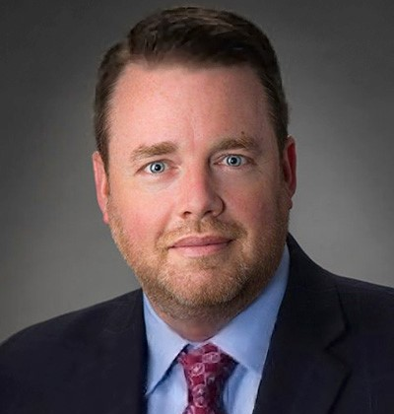
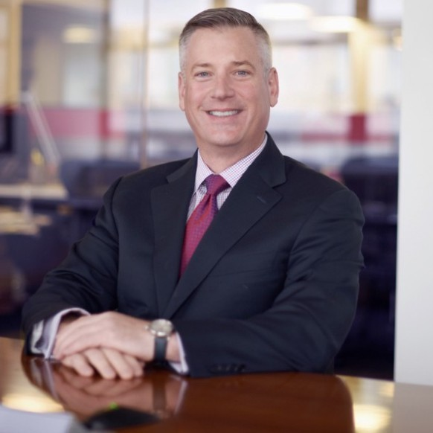
Session 11- April 20, 2022
      Strategy’
      Gordon Foster & Brian Drzewiecki
        CFO, SERCO CFO/COO, RII
Notes:
Mandatory Slide to introduce the next topic/session. To be briefed by the MC.

Slide 22
Placeholder for Section Overview
Section Title
Notes:
-expand or shorten width of orange box for even spacing on all sides of Section Title text

Slide 23
Placeholder For Title
Sample Subhead Goes Here
Sample body copy. Curabitur blandit tempus porttitor. Nullam id dolor id nibh ultricies vehicula ut id elit. Aenean lacinia bibendum nulla sed consectetur. Maecenas sed diam eget risus varius blandit sit amet non magna. Cum sociis natoque penatibus et magnis dis parturient montes, nascetur ridiculus mus.
  Bullet 1
  Bullet 2
  Bullet 3
  Bullet 4

Slide 24
PLACEHOLDER
Sample emphasized copy. Aenean eu leo quam. Pellentesque ornare sem lacinia quam venenatis vestibulum. Nullam id dolor id nibh ultricies vehicula ut id elit. Cras mattis consectetur purus sit amet fermentum.
Sample Subhead
Sample body copy. Curabitur blandit tempus porttitor. Nullam id dolor id nibh ultricies vehicula ut id elit.
  Sample Bullets
  Sample Bullets

Slide 25
PLACEHOLDER
Sample emphasized copy. Aenean eu leo quam. Pellentesque ornare sem lacinia quam venenatis vestibulum. Nullam id dolor id nibh ultricies vehicula ut id elit. Cras mattis consectetur purus sit amet fermentum.
Sample Subhead
Sample body copy. Curabitur blandit tempus porttitor. Nullam id dolor id nibh ultricies vehicula ut id elit.
  Sample Bullets
  Sample Bullets

Slide 26
Sample List
LINE 1
Line 2
LINE 1
Line 2
LINE 1
Line 2
LINE 1
Line 2
LINE 1
Line 2
LINE 1
Line 2
LINE 1
Line 2
LINE 1
Line 2
LINE 1
Line 2
LINE 1
Line 2
LINE 1
Line 2
LINE 1
Line 2

Slide 27
Sample Table
HEADER 1 | HEADER 2 | HEADER 3
Sample Text | Sample Text | Sample Text

Slide 28
Sample Table

