Slide 1
Session 3| August 18, 2021
Notes:
1st Addressable Slide to get started. To be briefed by the MC.

Slide 2
Session 3 – August 18, 2021
Event | Schedule
Arrival & Networking | 5:30PM – 6:00PM
Opening Remarks | 6:00PM – 6:15PM
Panel Discussion | 6:15PM – 7:30PM
Member Q&A | 7:30PM +
Notes:
To be briefed by the MC, then turning over to the Presenter of the Evening.

Slide 3

Opening Remarks
Updates:
3 CFO Rising Members have completed successful exits
Guests attending tonight's session
Website Updates
Raymond James Defense and Government Services Conference (9/23/21)
Exciting news coming from Stewart Leadership in the next few sessions
Wine upgrade
  CLIMB: Coach, Learn, Inform, Mentor, Benefit
Notes:
Mandatory slide to suggest the Goals for the Session. White space at right is flexible as needed.

Slide 4
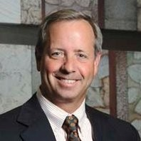
Meet our Panelists
Brad Antle
Executive Chairman- Oceus Networks
Brad Antle is the Executive Chairman for Oceus Networks. Antle has over three decades of experience as a leader in developing and delivering technology-based solutions at General Electric, Lockheed Martin, SI International, Salient CRGT and more recently at Antle Advisors.
As a founder of SI International and Salient CRGT, he grew each company to revenues exceeding $500M. Antle served in the U.S. Navy for 30 years Active & Reserve, retiring with the rank of Captain. He is active in numerous community and business organizations and is the past Chair of the Northern Virginia Technology Council (NVTC), Past Chair of the Software Productivity Consortium, Past Chair of the Virginia Veterans Services Foundation Board, and former Trustee of NDIA. Antle has chaired the Impact AI Summit for NVTC for the past two years, showcasing the Artificial Intelligence capabilities in the Greater Washington DC area.
He has an undergraduate degree from the University of Maryland, Master of Engineering from Penn State, and an MBA from National University.
Notes:
Mandatory slide of the presenter’s Bio. Presenter to craft as they see fit.

Slide 5
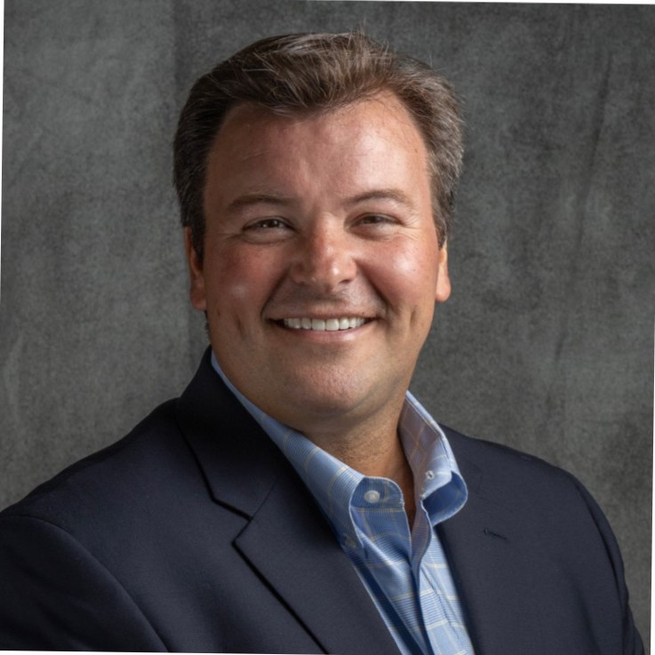
Kevin Mclaughlin
CEO- Copper River Shared Services
As CEO of Copper River Shared Services, Mr. McLaughlin is responsible for leading multiple facets of the organization. He directs the oversight of 12+ subsidiary companies with government contract portfolios of over $280MM and a workforce of over 500 employees across the U.S. and overseas. He is responsible for strategic long-term planning and leads multiple teams and business units within Shared Services to provide oversight and customer-focused support services to the Copper River Family of companies.
Mr. McLaughlin has had a significant impact on the Copper River Family. Immediately after joining Copper River, he quickly utilized prior skills helping Alaska Native-owned companies and his affinity for Alaska Native set aside laws and SBA 8 (a) regulations to set up Copper River Shared Services to provide back-office support and oversight for future growth. Mr. McLaughlin continues to be instrumental in the company’s expansion, playing a key role in six strategic acquisitions during his tenure. He also played a major role in the startup of seven additional subsidiary companies for the Copper River Family.
Notes:
Mandatory slide of the presenter’s Bio. Presenter to craft as they see fit.

Slide 6
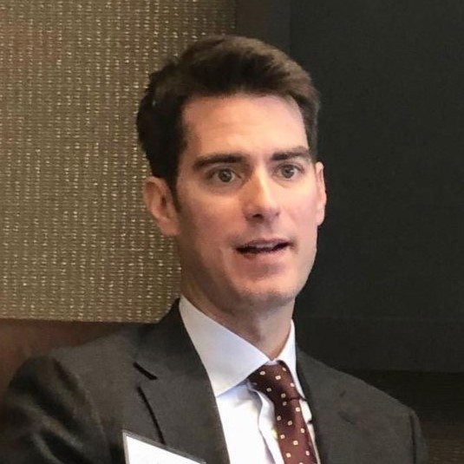
Greg Nossaman
Managing Director- G Squared Capital Partners
Greg Nossaman, a Co-Founder and Managing Director at G Squared Capital Partners, works with Aerospace, Defense and Government Services companies to maximize value through mergers & acquisitions.
Mr. Nossaman has focused exclusively on the Aerospace, Defense and Government Services sector since 2000, working with companies that specialize in a wide range of products and services, including information technology, healthcare IT, cybersecurity, defense technologies, systems engineering, software development, C4ISR, training and other technical and professional services. His clients have served nearly every facet of the federal government, including intelligence, defense, civilian and homeland security organizations. Mr. Nossaman has advised on and closed transactions with such industry leaders as BAE Systems, Booz Allen Hamilton, DRS Technologies, Honeywell, Lockheed Martin, ManTech International, Raytheon, and many more. He also has closed transactions with such leading private equity groups as AE Industrial Partners, Arlington Capital Partners, The Carlyle Group, CM Equity, Enlightenment, Sagewind Capital, and TPG.
Notes:
Mandatory slide of the presenter’s Bio. Presenter to craft as they see fit.

Slide 7
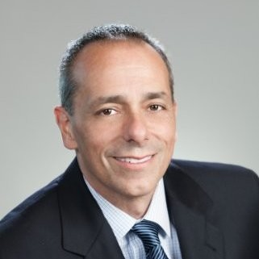
Joe Oliveri
President and CEO at CTSI
Joe Oliveri currently serves as President and CEO of CTSI, a Wind Point Partners Platform Company, which enables its customers to boost collaboration, increase life safety and security, and deliver enhanced communications. Mr. Oliveri joined the company in 2021, to lead the organization through accelerated acquisitive and organic growth, expand the company’s service portfolios and geographic reach, while improving business operations, customer service and financial performance metrics.
Prior to joining CTSI, Joe held senior executive positions with Johnson Controls and Tyco International, as VP and GM of Global Fire Detection Products, VP and GM of Global Ducted Systems, and VP and GM of the Security Division. His responsibilities included full P&L management and leadership of $4B divisions including Global Sales, Marketing, Strategy, M&A, R&D, Manufacturing and Retail with a span of control 8000 employees and 100+ field offices. He brings expertise in operations management, organizational growth, market penetration, accelerated revenue and EBITDA growth, M&A, innovation, and transformation. Joe earned his BS in Mechanical Engineering at Worcester Polytechnic Institute and his MBA at Northeastern University.
Notes:
Mandatory slide of the presenter’s Bio. Presenter to craft as they see fit.

Slide 8
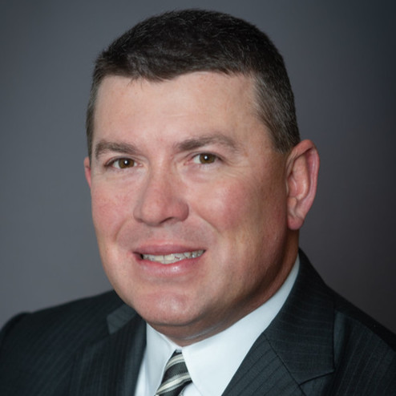
Wayne Wilkinson
Chief Operating Officer at Integral Consulting Services, Inc.
Wayne Wilkinson, an accomplished leader with experience leading defense, intelligence and technology organizations through periods of rapid growth and development. As COO, Wayne significantly strengthens the leadership of the company by providing a tremendous set of capabilities and a deep background within the IT services and intelligence analysis federal marketplace. A government contracting veteran with over twenty-five years of experience, his expertise spans all areas of business including strategic planning, business development, operations and finance. As chief operating officer, Wayne will be responsible for overseeing all operational aspects of the company and will work to further define the company’s vision for success.
Mr. Wilkinson has held several key executive roles at various government contracting organizations including Whitney, Bradley and Brown (WBB), Harding Security Associates, Athena Innovative Solutions and L-3. Most recently, he served as the chief operating officer at Ace Info Solutions.
Mr. Wilkinson holds a B.S. in accounting from Virginia Polytechnic Institute & State University and an M.B.A. from Marymount University.
Notes:
Mandatory slide of the presenter’s Bio. Presenter to craft as they see fit.

Slide 9
Panel Discussion
What do we want from a CFO?

Slide 10
‘See you back in 15 min’
Break
Notes:
Mandatory Slide if using a Break.

Slide 11
What can our Panelists answer for you?
Member Q&A
Notes:
Mandatory Slide if using a Break.

Slide 12
Our Journey Ahead
SESSION 1
Program Introduction
SESSION 2
Budgeting, Forecasting & Financial Reporting
SESSION 3
What do we want from a CFO?
SESSION 4
Capital Sources, Debt & Equity
SESSION 5
Audit & Tax
SESSION 6
Executive Leadership
SESSION 7
Indirect Rates & Pricing Strategy
SESSION 8
Buy & Sell Side M&A
SESSION 9
Communication, Team Building & Accountability
SESSION 10
CFO Oversight Areas & Continuing Education
SESSION 11
Strategy
SESSION 12
Program Recap-Capstone

Slide 13
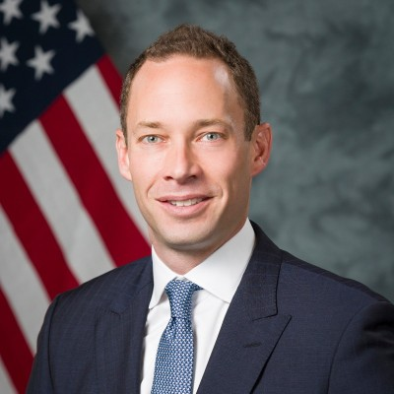
Session 4 – September 15, 2021
      Capital Sources, Debt and Equity’
      Nick Veasey
        CFO, MAG Aerospace
Notes:
Mandatory Slide to introduce the next topic/session. To be briefed by the MC.

